Slide 1
Course Project
Operating Systems
Module 6 System Performance Monitoring

Slide 2
Rubric
Activity | Requirement(s) | Points
Monitor processes | Answer two questions | 20
Monitor user activities | Answer two questions | 20
Monitor network bandwidth usage | Take a screenshot | 20

Slide 3
Monitor Linux processes
1. What is the default action of the 15 SIGTERM kill signal?
Answer here: To end the process/program
2. In the System Monitor window, click on % CPU to sort the processes by CPU load. Which process shows the highest percentage of CPU usage?
Answer here: gnome-system-monitor
References:
1. Live class lecture
2.

Slide 4
Monitor user activities
Issue the sudo accton on command to turn on GNC accounting. Run the sudo updatedb command. Enter lastcomm updatedb to check if the updatedb command was executed before. Remember to turn off GNC accounting (sudo accton off) after answering the questions.
1. What flag value is displayed in the output?
Answer here: .36 secs
2. Why is the name of the user who ran the processes shown as root, not student?
Answer here: The other users no longer exists
References:
1. Live Lecture
2.

Slide 5
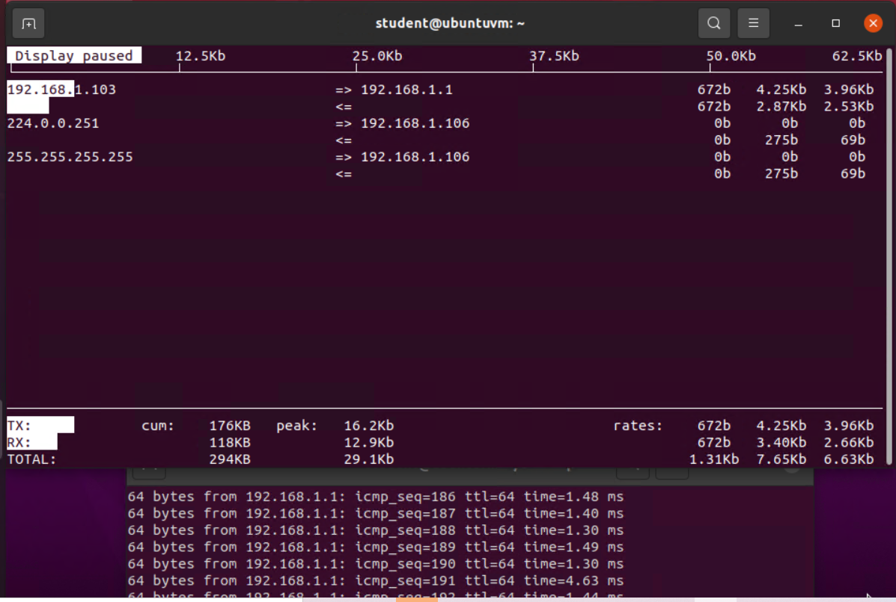
Monitor network bandwidth usage
Take a screenshot of the output in Step 4.

